Slide 1


Green Pace
Security Policy Presentation
Developer: Jordan Ballard

Slide 2

OVERVIEW: DEFENSE IN DEPTH
The security policy defines the ten core security principles and outlines ten coding standards to follow, including their descriptions, examples of noncompliant and compliant code, a mapping to the relevant security principle, threat level analysis, and automation tool suggestions. Following this is an overview of automation in the DevOps lifecycle, a summary of risk assessments, and an explanation of encryption and the Triple-A framework. This policy was needed to maximize automation for ensuring security compliance and to get ready for a company transition from DevOps to DevSecOps. It will help support defense-in-depth practices by adding layers of security.

Slide 3
THREATS MATRIX
These threats are considered “Likely” or “Probable” by CERT C++ Coding Standards
Likely | Priority
Low Priority | Unlikely
These threats have medium to high severity and medium remediation costs.
STD-002-CPP
STD-003-CPP
STD-004-CPP
STD-005-CPP
STD-007-CPP
STD-008-CPP
STD-009-CPP
STD-010-CPP
STD-002-CPP
STD-003-CPP
STD-004-CPP
STD-005-CPP
STD-008-CPP
These threats have low severity with low to medium remediation costs.
These threats are considered “Unlikely” by CERT C++ Coding Standards
STD-001-CPP
STD-006-CPP
STD-007-CPP
STD-009-CPP
STD-010-CPP
STD-001-CPP
STD-006-CPP

Slide 4
10 PRINCIPLES
Keep it Simple
STD-001-CPP
STD-007-CPP
STD-008-CPP
Default Deny
Adhere to the Principle of Least Privilege
Sanitize Data Sent to Other Systems
STD-004-CPP
Practice Defense in Depth
STD-003-CPP
STD-007-CPP
STD-010-CPP
Use Effective Quality Assurance Techniques
Adopt a Secure Coding Standard
STD-001-CPP
STD-003-CPP
STD-004-CPP
STD-006-CPP
Validate Input Data
STD-003-CPP
Heed Compiler Warnings
STD-002-CPP
STD-005-CPP
STD-006-CPP
STD-008-CPP
STD-010-CPP
Architect and Design for Security Policies
STD-001-CPP
STD-002-CPP
STD-004-CPP
STD-005-CPP
STD-006-CPP
STD-007-CPP
STD-008-CPP
STD-009-CPP
STD-010-CPP

Slide 5
CODING STANDARDS
Guarantee that Storage for Strings has Sufficient Space for Character Data and the Null Terminator
Sanitize Data Passed to Complex Subsystems
Do Not Read Uninitialized Memory
Value-Returning Functions Must Return a Value From All Exit Paths
Do Not Access Freed Memory
Handle All Exceptions
Honor Exception Specifications
Avoid Side Effects in Arguments to Unsafe Macros
Do Not Delete an Array Through a Pointer of the Incorrect Type
Do Not Attempt to Modify String Literals

Slide 6
ENCRYPTION POLICIES
In Flight
This type of encryption refers to data that is in motion over a network connection. Encryption may be done at one end or another but data also needs to be protected in transit. Even if the message is intercepted, the attacker won’t be able to decipher it.
At Rest
This type of encryption helps to protect data stored on disk, backup media, or a database by encrypting the information when it is not in use.
In Use
This type of encryption refers to protecting data that is currently being accessed or read. Data may be protected at rest or in flight, but is decrypted for use. Methods that allow data to be read while still encrypted should be used.

Slide 7
TRIPLE-A POLICIES
Authentication
Authentication is the process of verifying that a user is who they say they are through methods such as requiring usernames, passwords, biometrics, or multi-factor authentication when a user logs into a system. Different levels of user access means that different permissions will be granted depending on who the user is.
Authorization
Authorization refers to making sure that resources or areas of a network are only accessible by users with the proper authentication. Policies are enforcing security, restrictions (location, time of day, login frequency, multiple logins), filtering IP addresses, managing bandwidth traffic, and using encryption methods.
Accounting
Accounting is the process of keeping records of information about the system and how users interact with it. Policies are measuring resource consumption, logging session information, logging changes made, and monitoring information that is being sent or received.

Slide 8
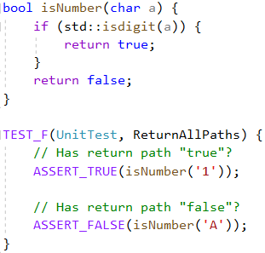
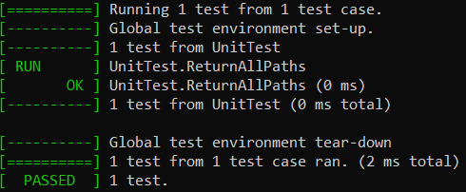
Vulnerability: Value Return
Ensure that Value-Returning Functions Return from All Exit Paths
Positive Test
This is an example of a positive test that ensures that all exit paths return a value. The isNumber() function returns a bool, so it is expected to return either true or false. The unit test runs two assert statements for each expected return value, and the test is passed.

Slide 9
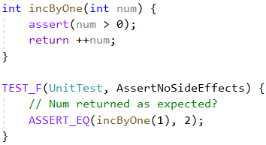
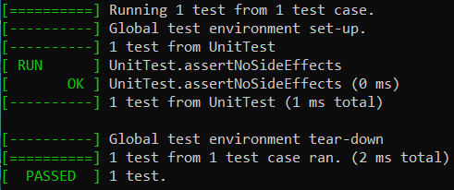
Vulnerability: Side Effects
Avoid Side Effects in Unsafe Macros
Positive Test
This is an example of a positive test that makes sure that the assert macro does not cause side effects. The incByOne() function contains an asset() statement. The unit test runs to validate that the number is not altered and returns as expected.

Slide 10
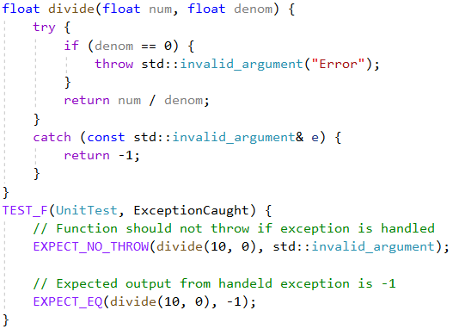
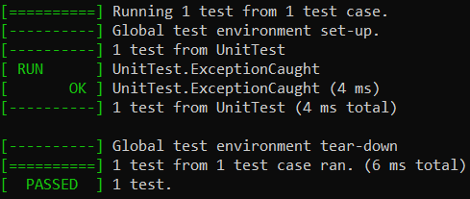
Vulnerability: Exception Handling
Handle All Exceptions
Negative Test
This is an example of a negative test that makes sure that a function throws an exception and handles it. The divide() function throws an exception if denominator is 0 and returns -1. The unit test verifies that the exception isn’t thrown to find another handler and is handled by returning the expected -1.

Slide 11
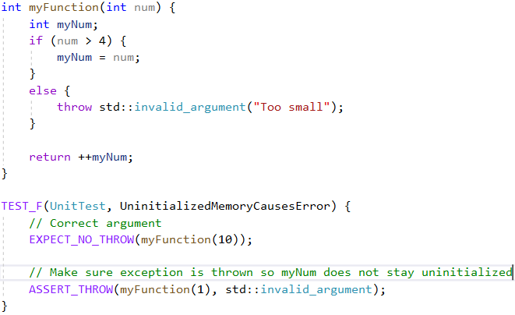
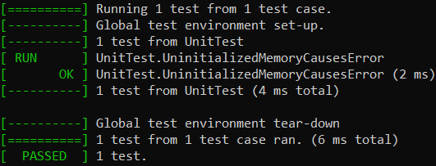
Vulnerability: Uninitialized Memory
Do Not Read Uninitialized Memory
Negative Test
This is an example of a negative test that makes sure that a function throws an exception to avoid accessing an uninitialized variable. The myFunction() function only assigns myNum if num is greater than 4. The unit test verifies that the exception is thrown before an uninitialized myNum is incremented.

Slide 12

AUTOMATION SUMMARY
Stages that will include automation:
Build
Compiler
Unit Tests
Verify and Test
Static Testing
Fuzz Testing
Transition
Penetration Testing
Monitor and Detect
Endpoint Protection
Threat Hunting
Respond
Automatic response to threats
Maintain

Slide 13
TOOLS
The DevSecsOps Pipeline is the integration of security in the software development lifecycle, starting early on and lasting throughout.
These are some tools that can be used in automation:
CppUnit: C++ port of JUnit, can perform automated unit testing.
CppCheck: Static analysis tool to detect bugs and undefined behavior.
Intruder: Automated penetration testing tool.
Bitdefender: Endpoint detection and response software.

Slide 14
RISKS AND BENEFITS
Problems
Cost
Time
Knowledge
Risks
Protecting the wrong areas
Missing deadlines
Implementing security incorrectly
Benefits
Preventable losses
Costs saved in the long run
Reputation protection
Guidelines and policy compliance
High quality products
Solutions
Start early
Automation
Consider hacker motivations
Define and categorize requirements
The current strategy is lacking in implementation of security throughout the DevOps pipeline. It is a risk to continue using this strategy because avoidable security vulnerabilities may be introduced. A culture of security should be established in the workplace and automated tools should be used in several of the stages. The updated security policy must be followed and revised as needed in order to make a full transition to DevSecOps.

Slide 15
RECOMMENDATIONS
Gaps in Existing Security Policy
Coding standards do not cover all standards
No policy for other programming languages
No coaching or workshops
No scalability support
Future Potential Gaps
New principles or standards
Newly identified vulnerabilities
Modifications to DevSecOps standards
Future Potential Improvements
Include a policy for other languages
Bring in DevSecOps coaches
Implement workshops
Create a coaching program to support scalability
When Comcast made the switch from DevOps to DevSecOps, the pilot team gathered a suite of automation tools to give to developers. They also brought in coaches to oversee groups and help them learn core practices. A DevOps team was able to be fully converted into DevSecOps in a year and a half if given regular coaching a workshops every 90 days. To support scaling, a coaching program was put into place to teach others outside of DevSecOps teams to be coaches for their own business unit. Within five years, Comcast had improved risk reduction by 85% with only a quarter of the staff previously required.
https://www.techtarget.com/searchsecurity/feature/Case-study-Scaling-DevSecOps-at-Comcast

Slide 16
CONCLUSIONS
The policy supports defense in depth
All principles and standards should be followed
All policies, including encryption and Triple-A, should be followed
Unit testing for vulnerabilities supports the policy
Automation should be implemented into multiple areas of the pipeline by using safe and effective tools.
Problems, risks, benefits, and solutions should be weighed
Coaching and workshops should be adopted to prevent future problems
New standards or strategies can be put in place by studying successful case studies

Slide 17
REFERENCES
Froehlich, A. (2022, July). How to secure data at rest, in use and in motion. TechTarget. https://www.techtarget.com/searchsecurity/feature/Best-practices-to-secure-data-at-rest-in-use- and-in-motion
Irel, A. (2022, May). Case study: Scaling DevSecOps at Comcast. TechTarget. https://www.techtarget.com/searchsecurity/feature/Case-study-Scaling-DevSecOps-at-Comcast
Mylonas, L. (2018, November 27). What is AAA security? An introduction to authentication, authorisation and accounting. Codebots. https://codebots.com/application-security/aaa-security-an-introduction- to-authentication-authorisation-accounting
SEI CERT C++ Coding Standard. (n.d.). Carnegie Melon University. https://wiki.sei.cmu.edu/confluence/pages/viewpage.action?pageId=88046682
Sweet, C. (n.d.). Don’t Leave Security for Last. Software Test Professionals. https://www.softwaretestpro.com/dont-leave-security-for-last/

